Slide 1


Slide 2


Slide 3
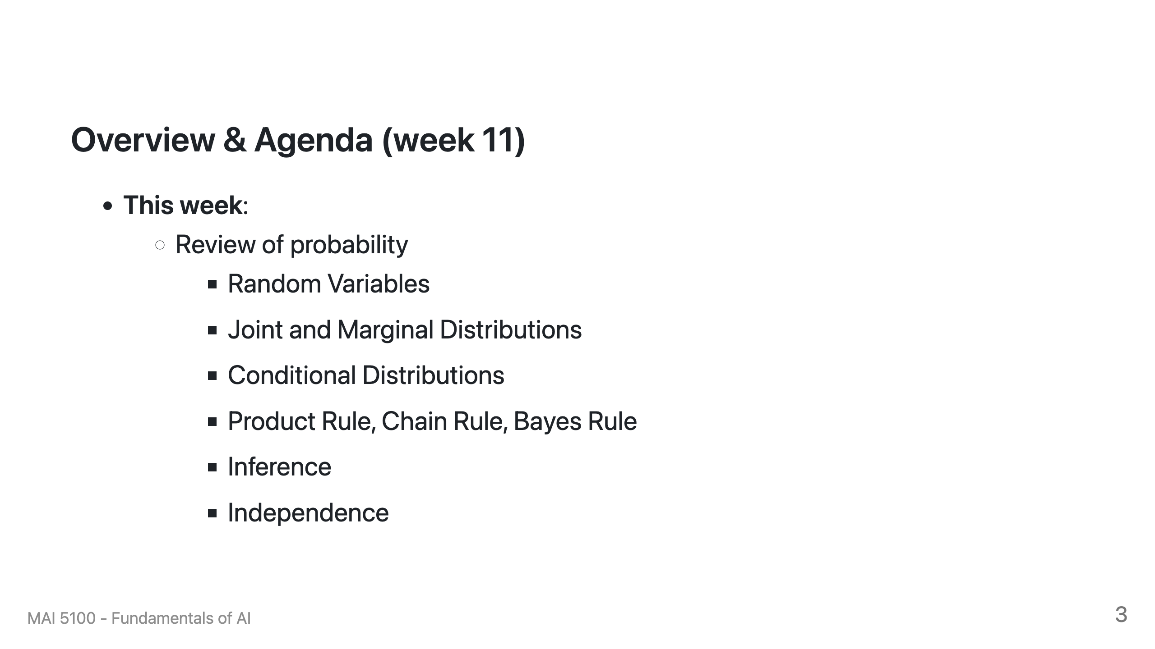

Slide 4
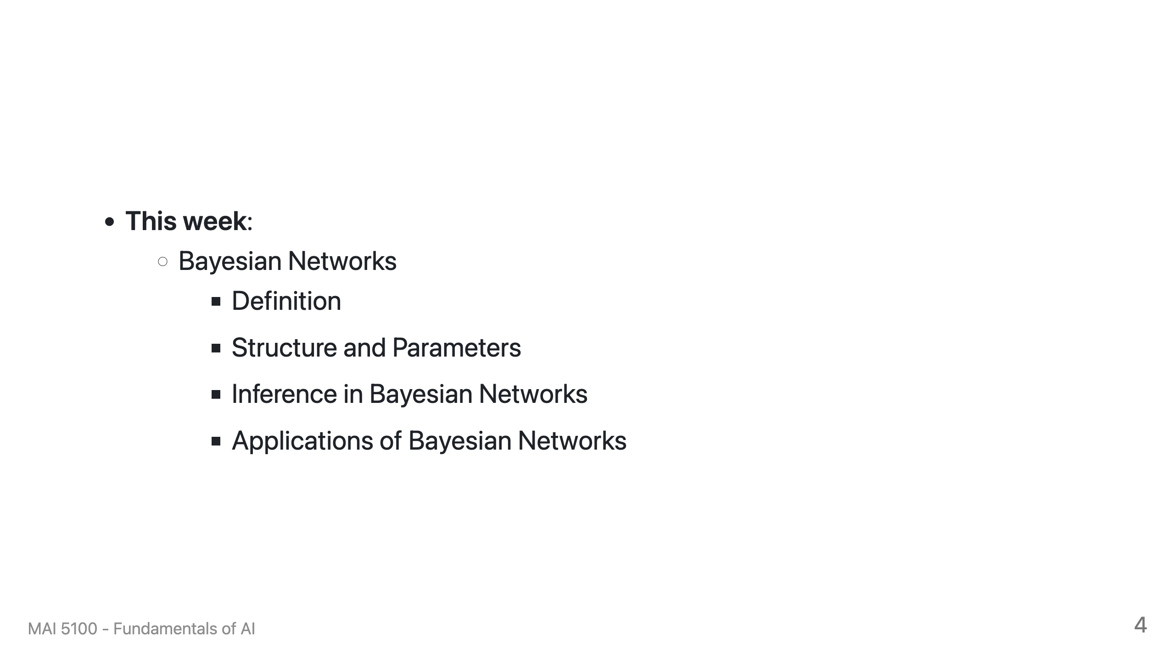

Slide 5
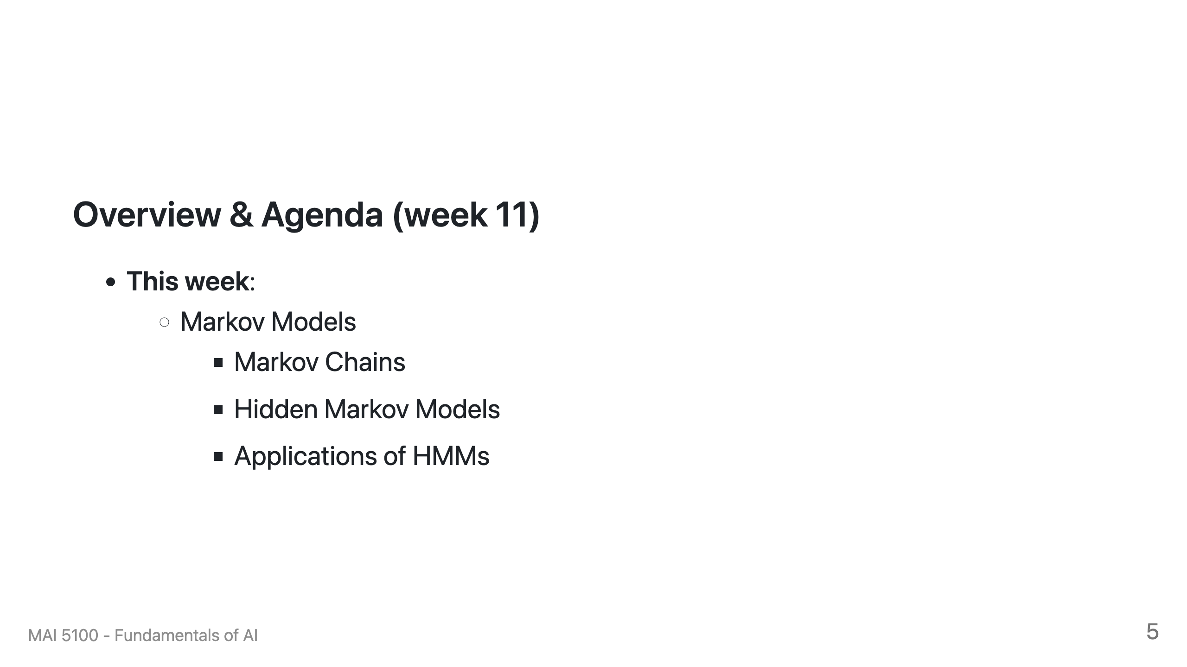

Slide 6

Today
Probability
Random Variables
Joint and Marginal Distributions
Conditional Distribution
Product Rule, Chain Rule, Bayes’ Rule
Inference
Independence
You’ll need all this stuff A LOT for the next few weeks, so make sure you go over it now!
Notes:
Like “sort this list” or “add these two numbers”

Slide 7
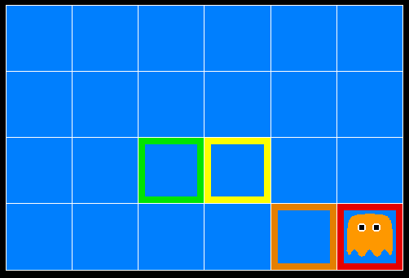
Inference in Ghostbusters
A ghost is in the grid somewhere
Sensor readings tell how close a square is to the ghost
On the ghost: red
1 or 2 away: orange
3 or 4 away: yellow
5+ away: green
Sensors are noisy, but we know P(Color | Distance)
P(red | 3) | P(orange | 3) | P(yellow | 3) | P(green | 3)
0.05 | 0.15 | 0.5 | 0.3
[Demo: Ghostbuster – no probability (L12D1) ]

Slide 8
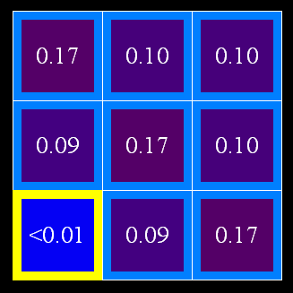
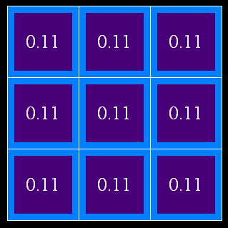
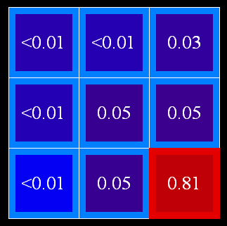
Uncertainty
General situation:
Observed variables (evidence): Agent knows certain things about the state of the world (e.g., sensor readings or symptoms)
Unobserved variables: Agent needs to reason about other aspects (e.g. where an object is or what disease is present)
Model: Agent knows something about how the known variables relate to the unknown variables
Probabilistic reasoning gives us a framework for managing our beliefs and knowledge

Slide 9
Random Variables
A random variable is some aspect of the world about which we (may) have uncertainty
R = Is it raining?
T = Is it hot or cold?
D = How long will it take to drive to work?
L = Where is the ghost?
We denote random variables with capital letters
Like variables in a CSP, random variables have domains
R in {true, false} (often write as {+r, -r})
T in {hot, cold}
D in [0, ∞)
L in possible locations, maybe {(0,0), (0,1), …}

Slide 10
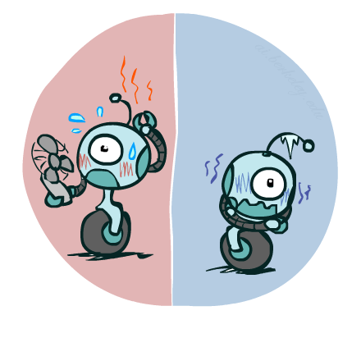
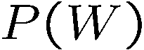
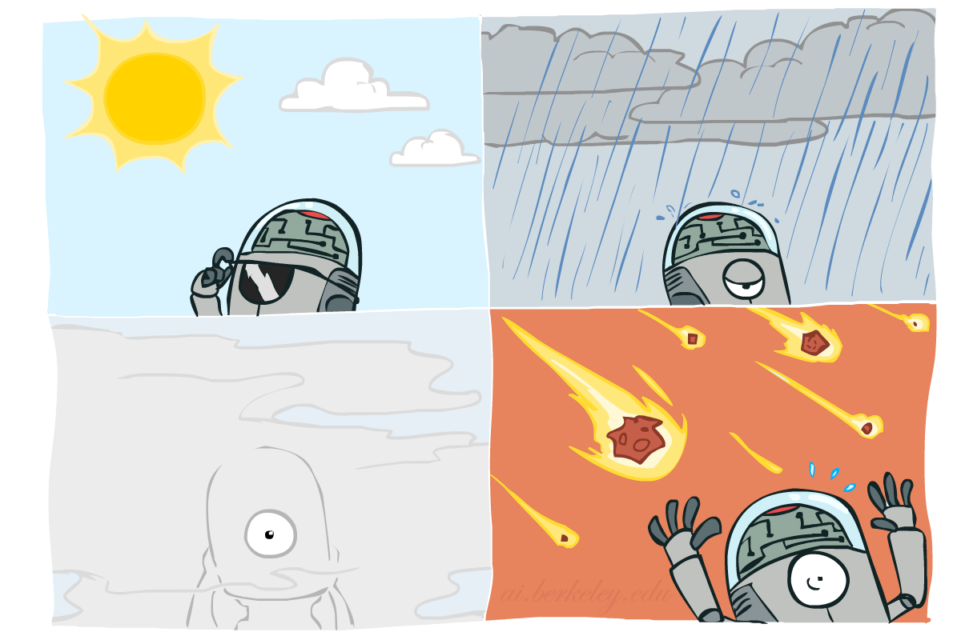
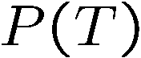
Probability Distributions
Associate a probability with each value
Temperature:
Weather:
W | P
sun | 0.6
rain | 0.1
fog | 0.3
meteor | 0.0
T | P
hot | 0.5
cold | 0.5

Slide 11

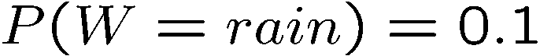
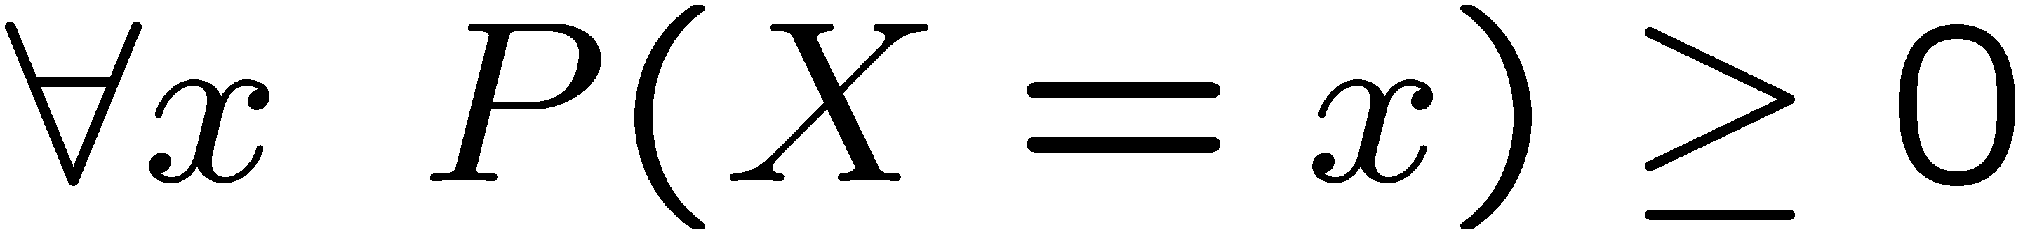
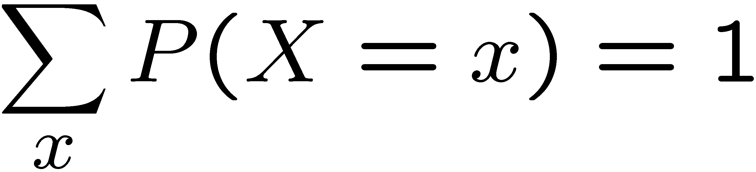
Probability Distributions
Unobserved random variables have distributions
A distribution is a TABLE of probabilities of values
A probability (lower case value) is a single number
Must have: and
Shorthand notation:
OK if all domain entries are unique
T | P
hot | 0.5
cold | 0.5
W | P
sun | 0.6
rain | 0.1
fog | 0.3
meteor | 0.0

Slide 12
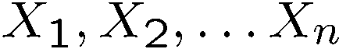
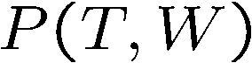
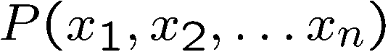
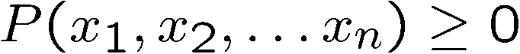
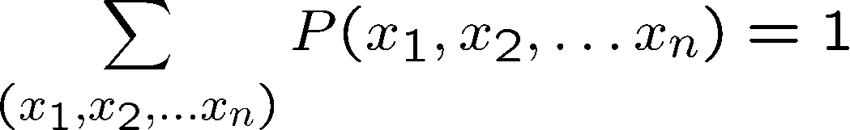
Joint Distributions
A joint distribution over a set of random variables:
specifies a real number for each assignment (or outcome):
Must obey:
Size of distribution if n variables with domain sizes d?
For all but the smallest distributions, impractical to write out!
T | W | P
hot | sun | 0.4
hot | rain | 0.1
cold | sun | 0.2
cold | rain | 0.3

Slide 13
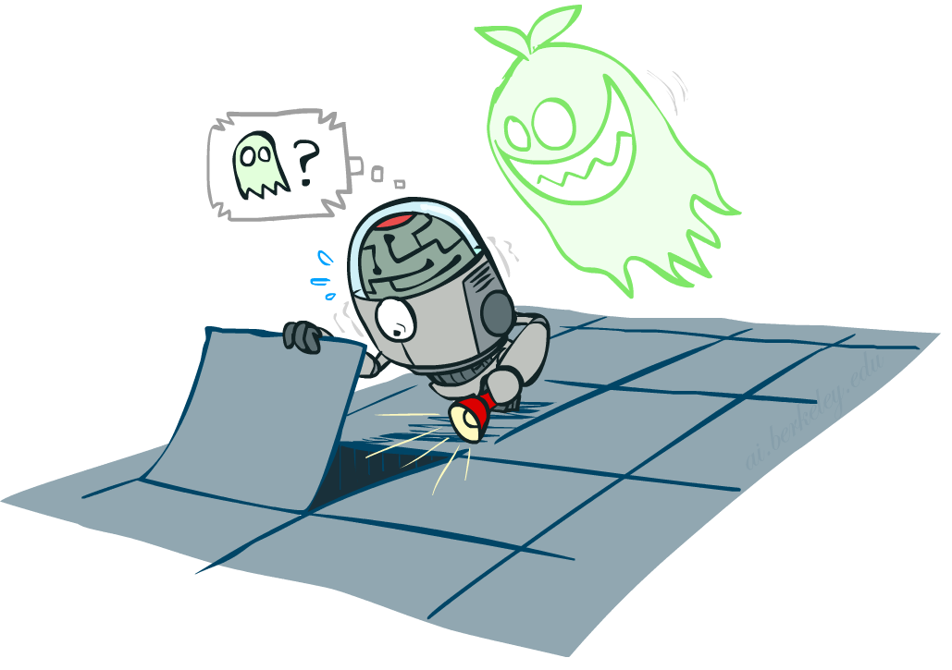

Probabilistic Models
Distribution over T,W
A probabilistic model is a joint distribution over a set of random variables
Probabilistic models:
(Random) variables with domains
Assignments are called outcomes
Joint distributions: say whether assignments (outcomes) are likely
Normalized: sum to 1.0
Ideally: only certain variables directly interact
Constraint satisfaction problems:
Variables with domains
Constraints: state whether assignments are possible
Ideally: only certain variables directly interact
T | W | P
hot | sun | 0.4
hot | rain | 0.1
cold | sun | 0.2
cold | rain | 0.3
Constraint over T,W
T | W | P
hot | sun | T
hot | rain | F
cold | sun | F
cold | rain | T

Slide 14
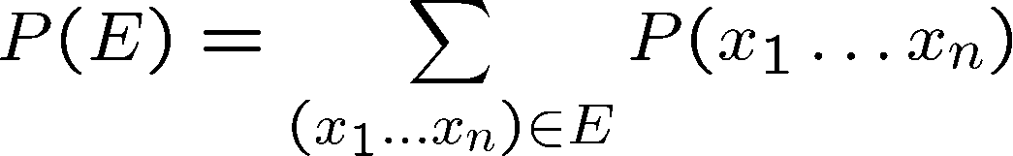
Events
An event is a set E of outcomes
From a joint distribution, we can calculate the probability of any event
Probability that it’s hot AND sunny?
Probability that it’s hot?
Probability that it’s hot OR sunny?
Typically, the events we care about are partial assignments, like P(T=hot)
T | W | P
hot | sun | 0.4
hot | rain | 0.1
cold | sun | 0.2
cold | rain | 0.3

Slide 15
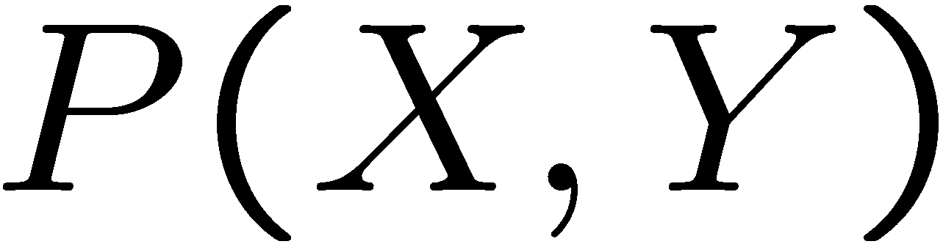
Quiz: Events
P(+x, +y) ?
P(+x) ?
P(-y OR +x) ?
X | Y | P
+x | +y | 0.2
+x | -y | 0.3
-x | +y | 0.4
-x | -y | 0.1

Slide 16
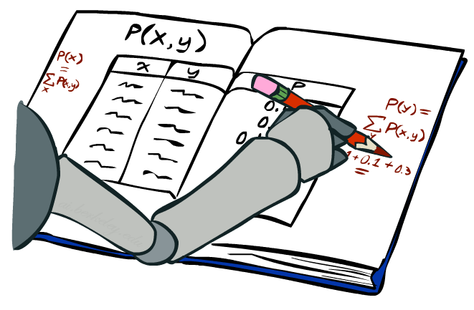
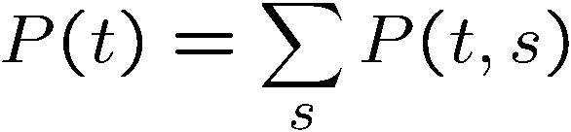
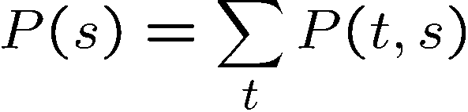
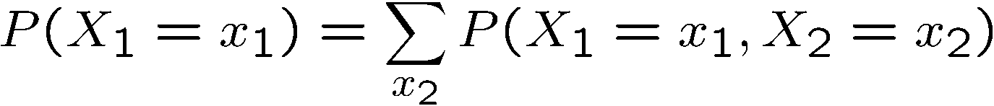
Marginal Distributions
Marginal distributions are sub-tables which eliminate variables
Marginalization (summing out): Combine collapsed rows by adding
T | P
hot | 0.5
cold | 0.5
T | W | P
hot | sun | 0.4
hot | rain | 0.1
cold | sun | 0.2
cold | rain | 0.3
W | P
sun | 0.6
rain | 0.4

Slide 17
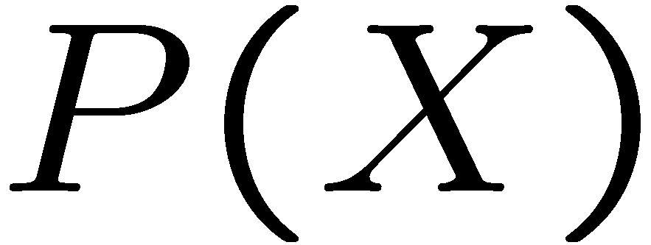
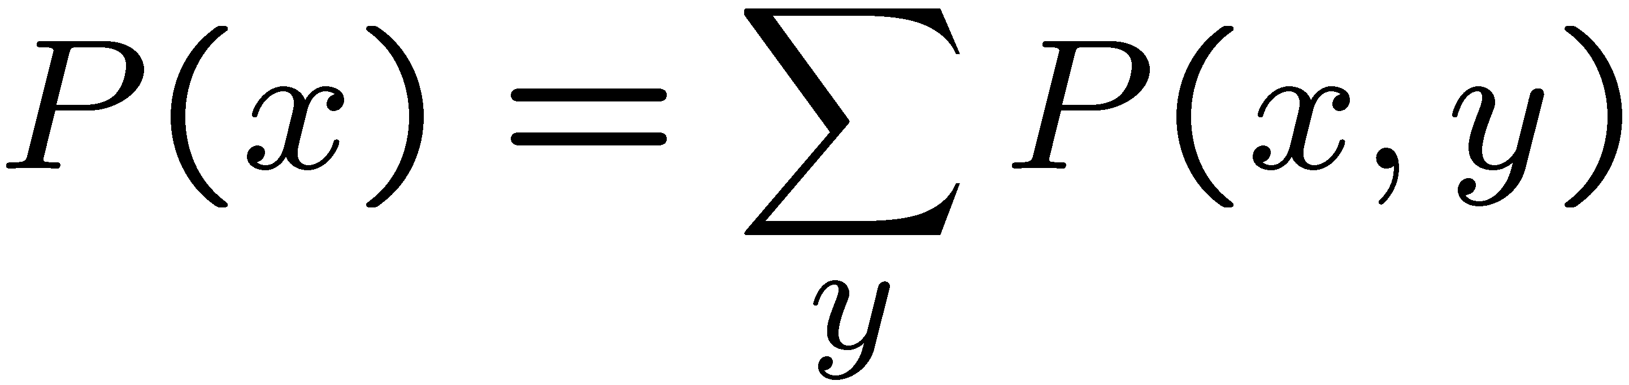
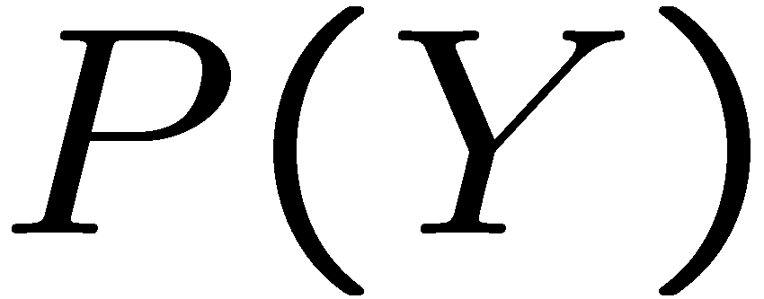
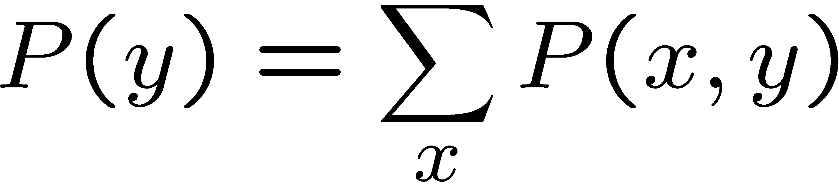
Quiz: Marginal Distributions
X | P
+x
-x
X | Y | P
+x | +y | 0.2
+x | -y | 0.3
-x | +y | 0.4
-x | -y | 0.1
Y | P
+y
-y

Slide 18
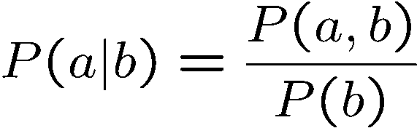
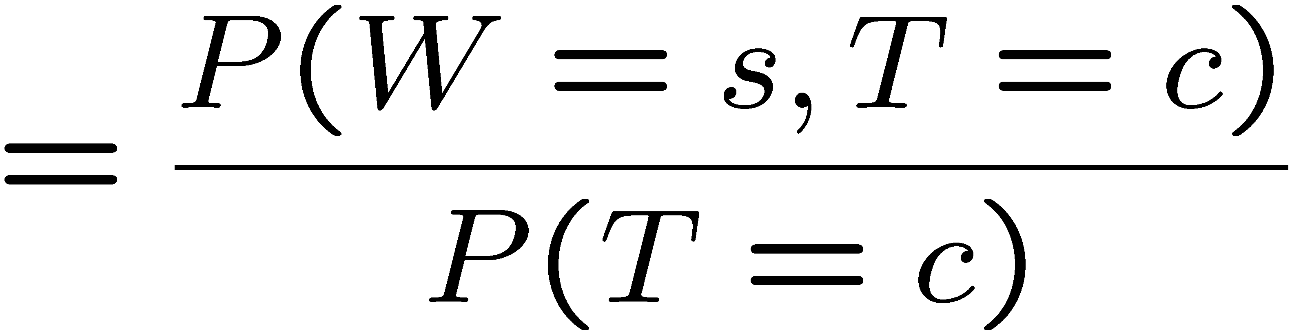
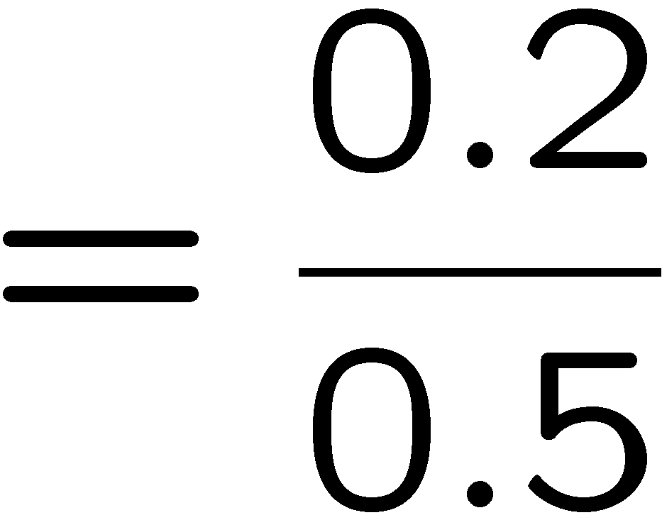



Conditional Probabilities
A simple relation between joint and conditional probabilities
In fact, this is taken as the definition of a conditional probability
P(a,b)
P(a)
P(b)
T | W | P
hot | sun | 0.4
hot | rain | 0.1
cold | sun | 0.2
cold | rain | 0.3

Slide 19
Quiz: Conditional Probabilities
P(+x | +y) ?
P(-x | +y) ?
P(-y | +x) ?
X | Y | P
+x | +y | 0.2
+x | -y | 0.3
-x | +y | 0.4
-x | -y | 0.1

Slide 20
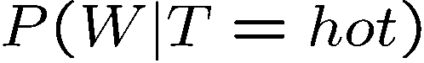
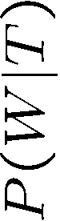
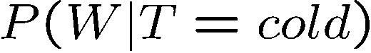
Conditional Distributions
Conditional distributions are probability distributions over some variables given fixed values of others
Conditional Distributions
Joint Distribution
W | P
sun | 0.8
rain | 0.2
T | W | P
hot | sun | 0.4
hot | rain | 0.1
cold | sun | 0.2
cold | rain | 0.3
W | P
sun | 0.4
rain | 0.6

Slide 21

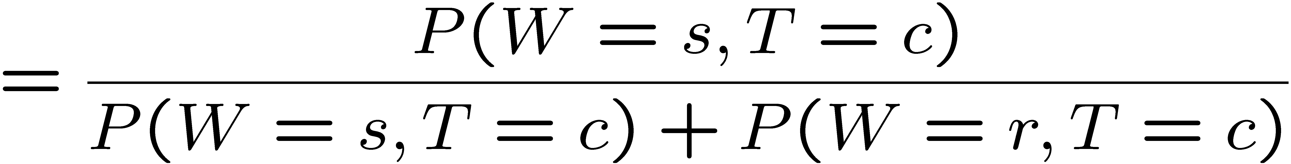
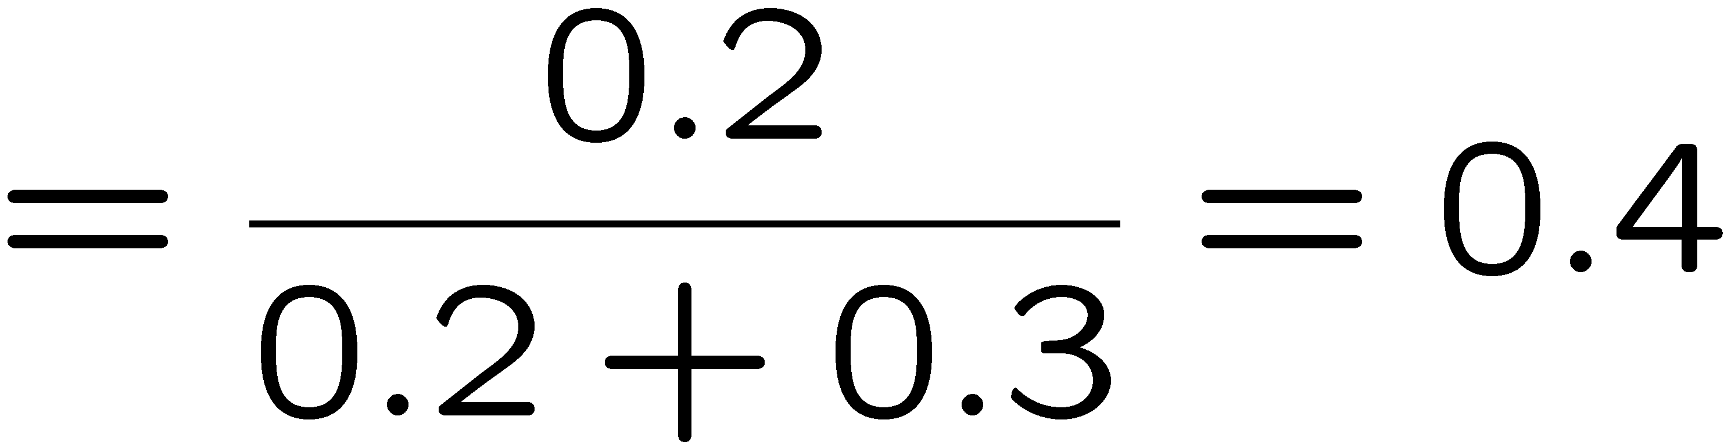
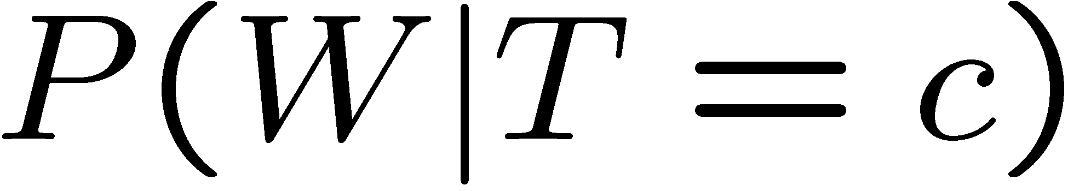
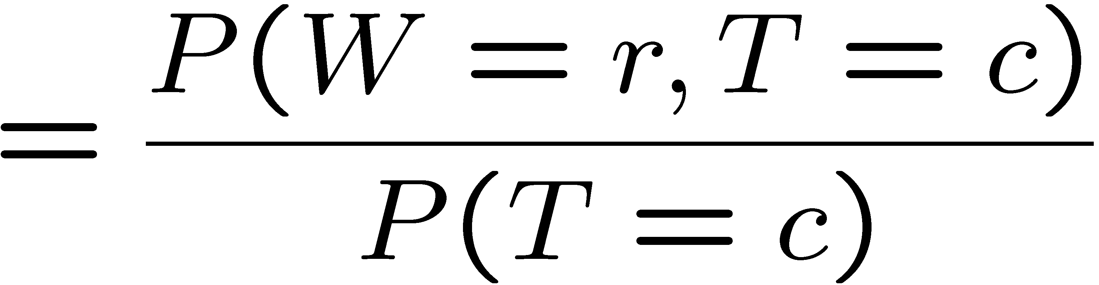

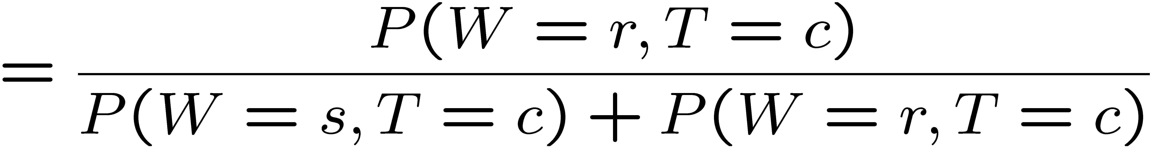
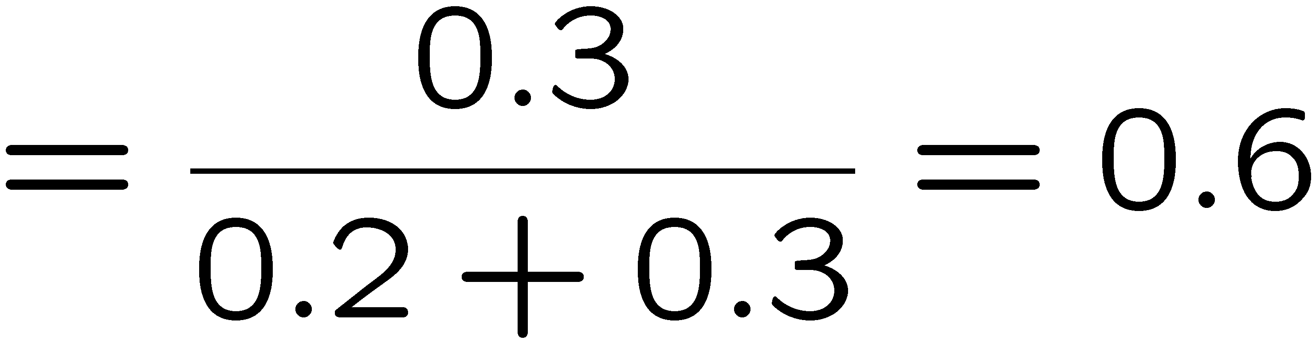
Normalization Trick
T | W | P
hot | sun | 0.4
hot | rain | 0.1
cold | sun | 0.2
cold | rain | 0.3
W | P
sun | 0.4
rain | 0.6

Slide 22
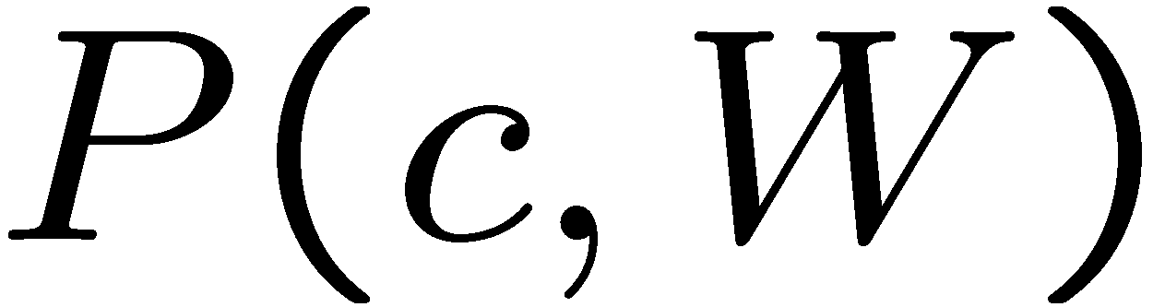
Normalization Trick
SELECT the joint probabilities matching the evidence
NORMALIZE the selection
(make it sum to one)
T | W | P
hot | sun | 0.4
hot | rain | 0.1
cold | sun | 0.2
cold | rain | 0.3
T | W | P
cold | sun | 0.2
cold | rain | 0.3
W | P
sun | 0.4
rain | 0.6

Slide 23
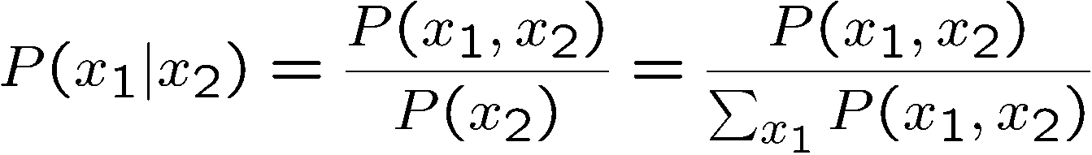
Normalization Trick
SELECT the joint probabilities matching the evidence
NORMALIZE the selection
(make it sum to one)
T | W | P
hot | sun | 0.4
hot | rain | 0.1
cold | sun | 0.2
cold | rain | 0.3
T | W | P
cold | sun | 0.2
cold | rain | 0.3
W | P
sun | 0.4
rain | 0.6
Why does this work? Sum of selection is P(evidence)! (P(T=c), here)

Slide 24
Quiz: Normalization Trick
P(X | Y=-y) ?
SELECT the joint probabilities matching the evidence
NORMALIZE the selection
(make it sum to one)
X | Y | P
+x | +y | 0.2
+x | -y | 0.3
-x | +y | 0.4
-x | -y | 0.1

Slide 25
To Normalize
(Dictionary) To bring or restore to a normal condition
Procedure:
Step 1: Compute Z = sum over all entries
Step 2: Divide every entry by Z
Example 1
All entries sum to ONE
Example 2
W | P
sun | 0.2
rain | 0.3
Normalize
W | P
sun | 0.4
rain | 0.6
T | W | P
hot | sun | 20
hot | rain | 5
cold | sun | 10
cold | rain | 15
T | W | P
hot | sun | 0.4
hot | rain | 0.1
cold | sun | 0.2
cold | rain | 0.3
Normalize
Z = 0.5
Z = 50

Slide 26

Probabilistic Inference
Probabilistic inference: compute a desired probability from other known probabilities (e.g. conditional from joint)
We generally compute conditional probabilities
P(on time | no reported accidents) = 0.90
These represent the agent’s beliefs given the evidence
Probabilities change with new evidence:
P(on time | no accidents, 5 a.m.) = 0.95
P(on time | no accidents, 5 a.m., raining) = 0.80
Observing new evidence causes beliefs to be updated

Slide 27
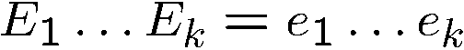
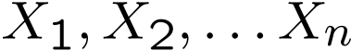
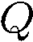
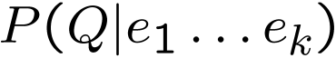
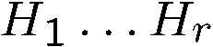
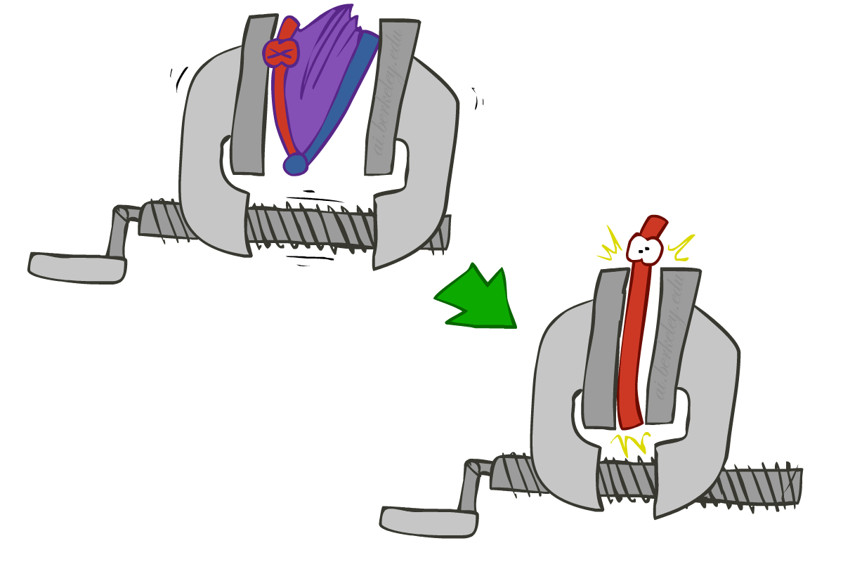





Inference by Enumeration
* Works fine with multiple query variables, too
General case:
Evidence variables:
Query* variable:
Hidden variables:
We want:
All variables
Step 1: Select the entries consistent with the evidence
Step 2: Sum out H to get joint of Query and evidence
Step 3: Normalize

Slide 28
Inference by Enumeration
P(W)?
P(W | winter)?
P(W | winter, hot)?
S | T | W | P
summer | hot | sun | 0.30
summer | hot | rain | 0.05
summer | cold | sun | 0.10
summer | cold | rain | 0.05
winter | hot | sun | 0.10
winter | hot | rain | 0.05
winter | cold | sun | 0.15
winter | cold | rain | 0.20

Slide 29
Inference by Enumeration
Obvious problems:
Worst-case time complexity O(d^{n})
Space complexity O(d^{n}) to store the joint distribution

Slide 30



The Product Rule
Sometimes have conditional distributions but want the joint

Slide 31


The Product Rule
Example:
D | W | P
wet | sun | 0.1
dry | sun | 0.9
wet | rain | 0.7
dry | rain | 0.3
D | W | P
wet | sun | 0.08
dry | sun | 0.72
wet | rain | 0.14
dry | rain | 0.06
R | P
sun | 0.8
rain | 0.2

Slide 32

The Chain Rule
More generally, can always write any joint distribution as an incremental product of conditional distributions
Why is this always true?

Slide 33

Bayes Rule

Slide 34




Bayes’ Rule
Two ways to factor a joint distribution over two variables:
Dividing, we get:
Why is this at all helpful?
Lets us build one conditional from its reverse
Often one conditional is tricky but the other one is simple
Foundation of many systems we’ll see later (e.g. ASR, MT)
In the running for most important AI equation!
That’s my rule!

Slide 35
Inference with Bayes’ Rule
Example: Diagnostic probability from causal probability:
Example:
M: meningitis, S: stiff neck
Note: posterior probability of meningitis still very small
Note: you should still get stiff necks checked out! Why?
Example
givens

Slide 36
Quiz: Bayes’ Rule
Given:
What is P(W | dry) ?
D | W | P
wet | sun | 0.1
dry | sun | 0.9
wet | rain | 0.7
dry | rain | 0.3
R | P
sun | 0.8
rain | 0.2

Slide 37

Ghostbusters, Revisited
Let’s say we have two distributions:
Prior distribution over ghost location: P(G)
Let’s say this is uniform
Sensor reading model: P(R | G)
Given: we know what our sensors do
R = reading color measured at (1,1)
E.g. P(R = yellow | G=(1,1)) = 0.1
We can calculate the posterior distribution P(G|r) over ghost locations given a reading using Bayes’ rule:
[Demo: Ghostbuster – with probability (L12D2) ]

Slide 38

Bayes’ Nets
Notes:
Please retain proper attribution, including the reference to ai.berkeley.edu. Thanks!

Slide 39

Probabilistic Models
Models describe how (a portion of) the world works
Models are always simplifications
May not account for every variable
May not account for all interactions between variables
“All models are wrong; but some are useful.” – George E. P. Box
What do we do with probabilistic models?
We (or our agents) need to reason about unknown variables, given evidence
Example: explanation (diagnostic reasoning)
Example: prediction (causal reasoning)
Example: value of information
Notes:
George Box: All models are wrong; some of them are useful

Slide 40

Independence

Slide 41


Independence
Two variables are independent if:
This says that their joint distribution factors into a product two simpler distributions
Another form:
We write:
Independence is a simplifying modeling assumption
Empirical joint distributions: at best “close” to independent
What could we assume for {Weather, Traffic, Cavity, Toothache}?

Slide 42




Example: Independence?
T | P
hot | 0.5
cold | 0.5
T | W | P
hot | sun | 0.4
hot | rain | 0.1
cold | sun | 0.2
cold | rain | 0.3
T | W | P
hot | sun | 0.3
hot | rain | 0.2
cold | sun | 0.3
cold | rain | 0.2
W | P
sun | 0.6
rain | 0.4

Slide 43


Example: Independence
N fair, independent coin flips:
H | 0.5
T | 0.5
H | 0.5
T | 0.5
H | 0.5
T | 0.5

Slide 44

Conditional Independence

Slide 45

Conditional Independence
P(Toothache, Cavity, Catch)
If I have a cavity, the probability that the probe catches in it doesn't depend on whether I have a toothache:
P(+catch | +toothache, +cavity) = P(+catch | +cavity)
The same independence holds if I don’t have a cavity:
P(+catch | +toothache, -cavity) = P(+catch| -cavity)
Catch is conditionally independent of Toothache given Cavity:
P(Catch | Toothache, Cavity) = P(Catch | Cavity)
Equivalent statements:
P(Toothache | Catch , Cavity) = P(Toothache | Cavity)
P(Toothache, Catch | Cavity) = P(Toothache | Cavity) P(Catch | Cavity)
One can be derived from the other easily

Slide 46

Conditional Independence
Unconditional (absolute) independence very rare (why?)
Conditional independence is our most basic and robust form of knowledge about uncertain environments.
X is conditionally independent of Y given Z
if and only if:
or, equivalently, if and only if

Slide 47

Conditional Independence
What about this domain:
Traffic
Umbrella
Raining

Slide 48


Conditional Independence
What about this domain:
Fire
Smoke
Alarm

Slide 49

Conditional Independence and the Chain Rule
Chain rule:
Trivial decomposition:
With assumption of conditional independence:
Bayes’nets / graphical models help us express conditional independence assumptions

Slide 50


Ghostbusters Chain Rule
Each sensor depends only on where the ghost is
That means, the two sensors are conditionally independent, given the ghost position
T: Top square is red B: Bottom square is red G: Ghost is in the top
Givens:
P( +g ) = 0.5
P( -g ) = 0.5
P( +t | +g ) = 0.8 P( +t | -g ) = 0.4 P( +b | +g ) = 0.4 P( +b | -g ) = 0.8
P(T,B,G) = P(G) P(T|G) P(B|G)
T | B | G | P(T,B,G)
+t | +b | +g | 0.16
+t | +b | -g | 0.16
+t | -b | +g | 0.24
+t | -b | -g | 0.04
-t | +b | +g | 0.04
-t | +b | -g | 0.24
-t | -b | +g | 0.06
-t | -b | -g | 0.06

Slide 51

Bayes’Nets: Big Picture

Slide 52

Bayes’ Nets: Big Picture
Two problems with using full joint distribution tables as our probabilistic models:
Unless there are only a few variables, the joint is WAY too big to represent explicitly
Hard to learn (estimate) anything empirically about more than a few variables at a time
Bayes’ nets: a technique for describing complex joint distributions (models) using simple, local distributions (conditional probabilities)
More properly called graphical models
We describe how variables locally interact
Local interactions chain together to give global, indirect interactions
For about 10 min, we’ll be vague about how these interactions are specified

Slide 53

Example Bayes’ Net: Insurance

Slide 54
Example Bayes’ Net: Car

Slide 55


Graphical Model Notation
Nodes: variables (with domains)
Can be assigned (observed) or unassigned (unobserved)
Arcs: interactions
Similar to CSP constraints
Indicate “direct influence” between variables
Formally: encode conditional independence (more later)
For now: imagine that arrows mean direct causation (in general, they don’t!)

Slide 56
Example: Coin Flips
N independent coin flips
No interactions between variables: absolute independence
X₁
X₂
X_{n}

Slide 57


Example: Traffic
Variables:
R: It rains
T: There is traffic
Model 1: independence
Why is an agent using model 2 better?
Model 2: rain causes traffic
R
R
T
T

Slide 58

Example: Traffic II
Let’s build a causal graphical model!
Variables
T: Traffic
R: It rains
L: Low pressure
D: Roof drips
B: Ballgame
C: Cavity

Slide 59

Example: Alarm Network
Variables
B: Burglary
A: Alarm goes off
M: Mary calls
J: John calls
E: Earthquake!

Slide 60

Bayes’ Net Semantics

Slide 61



Bayes’ Net Semantics
A set of nodes, one per variable X
A directed, acyclic graph
A conditional distribution for each node
A collection of distributions over X, one for each combination of parents’ values
CPT: conditional probability table
Description of a noisy “causal” process
A₁
A_{n}
X
A Bayes net = Topology (graph) + Local Conditional Probabilities

Slide 62


Probabilities in BNs
Bayes’ nets implicitly encode joint distributions
As a product of local conditional distributions
To see what probability a BN gives to a full assignment, multiply all the relevant conditionals together:
Example:

Slide 63

Probabilities in BNs
Why are we guaranteed that setting
results in a proper joint distribution?
Chain rule (valid for all distributions):
Assume conditional independences:
→ Consequence:
Not every BN can represent every joint distribution
The topology enforces certain conditional independencies

Slide 64
Example: Coin Flips
X₁
X₂
X_{n}
h | 0.5
t | 0.5
h | 0.5
t | 0.5
h | 0.5
t | 0.5
Only distributions whose variables are absolutely independent can be represented by a Bayes’ net with no arcs.
Notes:
demo

Slide 65



Example: Traffic
R
+r | 1/4
-r | 3/4
+r | +t | 3/4
 | -t | 1/4
T
-r | +t | 1/2
 | -t | 1/2
Notes:
demo

Slide 66

Example: Alarm Network
B | P(B)
+b | 0.001
-b | 0.999
E | P(E)
+e | 0.002
-e | 0.998
Burglary
Earthqk
Alarm
B | E | A | P(A|B,E)
+b | +e | +a | 0.95
+b | +e | -a | 0.05
+b | -e | +a | 0.94
+b | -e | -a | 0.06
-b | +e | +a | 0.29
-b | +e | -a | 0.71
-b | -e | +a | 0.001
-b | -e | -a | 0.999
John calls
Mary calls
A | J | P(J|A)
+a | +j | 0.9
+a | -j | 0.1
-a | +j | 0.05
-a | -j | 0.95
A | M | P(M|A)
+a | +m | 0.7
+a | -m | 0.3
-a | +m | 0.01
-a | -m | 0.99
Notes:
demo

Slide 67

Example: Traffic
Causal direction
R
+r | 1/4
-r | 3/4
+r | +t | 3/16
+r | -t | 1/16
-r | +t | 6/16
-r | -t | 6/16
+r | +t | 3/4
 | -t | 1/4
T
-r | +t | 1/2
 | -t | 1/2

Slide 68


Example: Reverse Traffic
Reverse causality?
T
+t | 9/16
-t | 7/16
+r | +t | 3/16
+r | -t | 1/16
-r | +t | 6/16
-r | -t | 6/16
+t | +r | 1/3
 | -r | 2/3
R
-t | +r | 1/7
 | -r | 6/7

Slide 69

Causality?
When Bayes’ nets reflect the true causal patterns:
Often simpler (nodes have fewer parents)
Often easier to think about
Often easier to elicit from experts
BNs need not actually be causal
Sometimes no causal net exists over the domain (especially if variables are missing)
E.g. consider the variables Traffic and Drips
End up with arrows that reflect correlation, not causation
What do the arrows really mean?
Topology may happen to encode causal structure
Topology really encodes conditional independence

Slide 70
Bayes’ Nets
So far: how a Bayes’ net encodes a joint distribution
Next: how to answer queries about that distribution
Today:
First assembled BNs using an intuitive notion of conditional independence as causality
Then saw that key property is conditional independence
Main goal: answer queries about conditional independence and influence
After that: how to answer numerical queries (inference)

Slide 71

Bayes’ Nets: Independence
Notes:
Please retain proper attribution, including the reference to ai.berkeley.edu. Thanks!

Slide 72

Bayes’ Nets
A Bayes’ net is an
efficient encoding
of a probabilistic
model of a domain
Questions we can ask:
Inference: given a fixed BN, what is P(X | e)?
Representation: given a BN graph, what kinds of distributions can it encode?
Modeling: what BN is most appropriate for a given domain?

Slide 73



Bayes’ Net Semantics
A directed, acyclic graph, one node per random variable
A conditional probability table (CPT) for each node
A collection of distributions over X, one for each combination of parents’ values
Bayes’ nets implicitly encode joint distributions
As a product of local conditional distributions
To see what probability a BN gives to a full assignment, multiply all the relevant conditionals together:

Slide 74

Example: Alarm Network
B | P(B)
+b | 0.001
-b | 0.999
B
E
E | P(E)
+e | 0.002
-e | 0.998
A
A | J | P(J|A)
+a | +j | 0.9
+a | -j | 0.1
-a | +j | 0.05
-a | -j | 0.95
A | M | P(M|A)
+a | +m | 0.7
+a | -m | 0.3
-a | +m | 0.01
-a | -m | 0.99
B | E | A | P(A|B,E)
+b | +e | +a | 0.95
+b | +e | -a | 0.05
+b | -e | +a | 0.94
+b | -e | -a | 0.06
-b | +e | +a | 0.29
-b | +e | -a | 0.71
-b | -e | +a | 0.001
-b | -e | -a | 0.999
J
M
Notes:
demo

Slide 75

Example: Alarm Network
B | P(B)
+b | 0.001
-b | 0.999
B
E
E | P(E)
+e | 0.002
-e | 0.998
A
A | J | P(J|A)
+a | +j | 0.9
+a | -j | 0.1
-a | +j | 0.05
-a | -j | 0.95
A | M | P(M|A)
+a | +m | 0.7
+a | -m | 0.3
-a | +m | 0.01
-a | -m | 0.99
B | E | A | P(A|B,E)
+b | +e | +a | 0.95
+b | +e | -a | 0.05
+b | -e | +a | 0.94
+b | -e | -a | 0.06
-b | +e | +a | 0.29
-b | +e | -a | 0.71
-b | -e | +a | 0.001
-b | -e | -a | 0.999
J
M
Notes:
demo

Slide 76


Size of a Bayes’ Net
How big is a joint distribution over N Boolean variables?
2^{N}
How big is an N-node net if nodes have up to k parents?
O(N * 2^{k+1})
Both give you the power to calculate
BNs: Huge space savings!
Also easier to elicit local CPTs
Also faster to answer queries (coming)

Slide 77

Bayes’ Nets
Representation
Conditional Independences
Probabilistic Inference
Learning Bayes’ Nets from Data

Slide 78



Conditional Independence
X and Y are independent if
X and Y are conditionally independent given Z
(Conditional) independence is a property of a distribution
Example:

Slide 79

Bayes Nets: Assumptions
Assumptions we are required to make to define the Bayes net when given the graph:
Beyond above “chain rule → Bayes net” conditional independence assumptions
Often additional conditional independences
They can be read off the graph
Important for modeling: understand assumptions made when choosing a Bayes net graph
Notes:
Important for modeling: understanding which assumptions you are making!

Slide 80
Example
X
Y
Z
W
Conditional independence assumptions directly from simplifications in chain rule:
Additional implied conditional independence assumptions?

Slide 81
Independence in a BN
Important question about a BN:
Are two nodes independent given certain evidence?
If yes, can prove using algebra (tedious in general)
If no, can prove with a counter example
Example:
Question: are X and Z necessarily independent?
Answer: no. Example: low pressure causes rain, which causes traffic.
X can influence Z, Z can influence X (via Y)
Addendum: they could be independent: how?
X
Y
Z

Slide 82

D-separation: Outline

Slide 83
D-separation: Outline
Study independence properties for triples
Analyze complex cases in terms of member triples
D-separation: a condition / algorithm for answering such queries

Slide 84

Causal Chains
This configuration is a “causal chain”
Guaranteed X independent of Z ? No!
One example set of CPTs for which X is not independent of Z is sufficient to show this independence is not guaranteed.
Example:
Low pressure causes rain causes traffic,
high pressure causes no rain causes no
traffic
In numbers:
P( +y | +x ) = 1, P( -y | - x ) = 1,
P( +z | +y ) = 1, P( -z | -y ) = 1
X: Low pressure Y: Rain Z: Traffic

Slide 85



Causal Chains
This configuration is a “causal chain”
Guaranteed X independent of Z given Y?
Evidence along the chain “blocks” the influence
X: Low pressure Y: Rain Z: Traffic
Yes!

Slide 86

Common Cause
This configuration is a “common cause”
Guaranteed X independent of Z ? No!
One example set of CPTs for which X is not independent of Z is sufficient to show this independence is not guaranteed.
Example:
Project due causes both forums busy
and lab full
In numbers:
P( +x | +y ) = 1, P( -x | -y ) = 1,
P( +z | +y ) = 1, P( -z | -y ) = 1
Y: Project due
X: Forums busy
Z: Lab full

Slide 87

Common Cause
This configuration is a “common cause”
Guaranteed X and Z independent given Y?
Observing the cause blocks influence between effects.
Y: Project due
X: Forums busy
Z: Lab full
Yes!

Slide 88

Common Effect
Last configuration: two causes of one effect (v-structures)
Are X and Y independent?
Yes: the ballgame and the rain cause traffic, but they are not correlated
Still need to prove they must be (try it!)
Are X and Y independent given Z?
No: seeing traffic puts the rain and the ballgame in competition as explanation.
This is backwards from the other cases
Observing an effect activates influence between possible causes.
X: Raining
Y: Ballgame
Z: Traffic

Slide 89

The General Case

Slide 90

The General Case
General question: in a given BN, are two variables independent (given evidence)?
Solution: analyze the graph
Any complex example can be broken
into repetitions of the three canonical cases

Slide 91


Reachability
L
Recipe: shade evidence nodes, look for paths in the resulting graph
Attempt 1: if two nodes are connected by an undirected path not blocked by a shaded node, they are conditionally independent
Almost works, but not quite
Where does it break?
Answer: the v-structure at T doesn’t count as a link in a path unless “active”
R
B
D
T

Slide 92
Active / Inactive Paths
Question: Are X and Y conditionally independent given evidence variables {Z}?
Yes, if X and Y “d-separated” by Z
Consider all (undirected) paths from X to Y
No active paths = independence!
A path is active if each triple is active:
Causal chain A → B → C where B is unobserved (either direction)
Common cause A ← B → C where B is unobserved
Common effect (aka v-structure)
A → B ← C where B or one of its descendents is observed
All it takes to block a path is a single inactive segment
Active Triples
Inactive Triples

Slide 93



D-Separation
?
Query:
Check all (undirected!) paths between and
If one or more active, then independence not guaranteed
Otherwise (i.e. if all paths are inactive),
then independence is guaranteed

Slide 94



Example
Yes
R
B
T
T’
Notes:
T’: traffic report

Slide 95





Example
L
Yes
R
B
Yes
D
T
Yes
T’

Slide 96



Example
Variables:
R: Raining
T: Traffic
D: Roof drips
S: I’m sad
Questions:
R
T
D
S
Yes

Slide 97

Structure Implications
Given a Bayes net structure, can run d-separation algorithm to build a complete list of conditional independences that are necessarily true of the form
This list determines the set of probability distributions that can be represented

Slide 98

Computing All Independences
Y
X
Z
Y
X
Z
X
Z
Y
Y
X
Z

Slide 99
Topology Limits Distributions
Given some graph topology G, only certain joint distributions can be encoded
The graph structure guarantees certain (conditional) independences
(There might be more independence)
Adding arcs increases the set of distributions, but has several costs
Full conditioning can encode any distribution
Y
Y
X
Z
X
Z
Y
X
Z
Y
X
Z
Y
Y
Y
X
Z
X
Z
X
Z
Y
Y
Y
X
Z
X
Z
X
Z

Slide 100
Bayes Nets Representation Summary
Bayes nets compactly encode joint distributions
Guaranteed independencies of distributions can be deduced from BN graph structure
D-separation gives precise conditional independence guarantees from graph alone
A Bayes’ net’s joint distribution may have further (conditional) independence that is not detectable until you inspect its specific distribution

Slide 101
Bayes’ Nets
Representation
Conditional Independences
Probabilistic Inference
Enumeration (exact, exponential complexity)
Variable elimination (exact, worst-case
exponential complexity, often better)
Probabilistic inference is NP-complete
Sampling (approximate)
Learning Bayes’ Nets from Data

Slide 102

Inference
Inference: calculating some useful quantity from a joint probability distribution
Examples:
Posterior probability
Most likely explanation:

Slide 103
Inference by Enumeration
* Works fine with multiple query variables, too
General case:
Evidence variables:
Query* variable:
Hidden variables:
We want:
All variables
Step 1: Select the entries consistent with the evidence
Step 2: Sum out H to get joint of Query and evidence
Step 3: Normalize

Slide 104
Inference by Enumeration in Bayes’ Net
Given unlimited time, inference in BNs is easy
Reminder of inference by enumeration by example:
B
E
A
J
M

Slide 105

Inference by Enumeration?

Slide 106


Inference by Enumeration vs. Variable Elimination
Why is inference by enumeration so slow?
You join up the whole joint distribution before you sum out the hidden variables
Idea: interleave joining and marginalizing!
Called “Variable Elimination”
Still NP-hard, but usually much faster than inference by enumeration
First we’ll need some new notation: factors

Slide 107

Factor Zoo

Slide 108


Factor Zoo I
Joint distribution: P(X,Y)
Entries P(x,y) for all x, y
Sums to 1
Selected joint: P(x,Y)
A slice of the joint distribution
Entries P(x,y) for fixed x, all y
Sums to P(x)
Number of capitals = dimensionality of the table
T | W | P
hot | sun | 0.4
hot | rain | 0.1
cold | sun | 0.2
cold | rain | 0.3
T | W | P
cold | sun | 0.2
cold | rain | 0.3

Slide 109






Factor Zoo II
Single conditional: P(Y | x)
Entries P(y | x) for fixed x, all y
Sums to 1
Family of conditionals:
P(X |Y)
Multiple conditionals
Entries P(x | y) for all x, y
Sums to |Y|
T | W | P
cold | sun | 0.4
cold | rain | 0.6
T | W | P
hot | sun | 0.8
hot | rain | 0.2
cold | sun | 0.4
cold | rain | 0.6

Slide 110




Factor Zoo III
Specified family: P( y | X )
Entries P(y | x) for fixed y,
but for all x
Sums to … who knows!
T | W | P
hot | rain | 0.2
cold | rain | 0.6

Slide 111




Factor Zoo Summary
In general, when we write P(Y₁ … Y_{N} | X₁ … X_{M})
It is a “factor,” a multi-dimensional array
Its values are P(y₁ … y_{N} | x₁ … x_{M})
Any assigned (=lower-case) X or Y is a dimension missing (selected) from the array

Slide 112



Example: Traffic Domain
Random Variables
R: Raining
T: Traffic
L: Late for class!
+r | 0.1
-r | 0.9
R
T
+r | +t | 0.8
+r | -t | 0.2
-r | +t | 0.1
-r | -t | 0.9
L
+t | +l | 0.3
+t | -l | 0.7
-t | +l | 0.1
-t | -l | 0.9

Slide 113

Variable Elimination (VE)

Slide 114







Inference by Enumeration: Procedural Outline
Track objects called factors
Initial factors are local CPTs (one per node)
Any known values are selected
E.g. if we know , the initial factors are
Procedure: Join all factors, then eliminate all hidden variables
+r | 0.1
-r | 0.9
+r | +t | 0.8
+r | -t | 0.2
-r | +t | 0.1
-r | -t | 0.9
+t | +l | 0.3
+t | -l | 0.7
-t | +l | 0.1
-t | -l | 0.9
+r | 0.1
-r | 0.9
+r | +t | 0.8
+r | -t | 0.2
-r | +t | 0.1
-r | -t | 0.9
+t | +l | 0.3
-t | +l | 0.1

Slide 115





Operation 1: Join Factors
First basic operation: joining factors
Combining factors:
Just like a database join
Get all factors over the joining variable
Build a new factor over the union of the variables involved
Example: Join on R
Computation for each entry: pointwise products
R
+r | 0.1
-r | 0.9
+r | +t | 0.8
+r | -t | 0.2
-r | +t | 0.1
-r | -t | 0.9
+r | +t | 0.08
+r | -t | 0.02
-r | +t | 0.09
-r | -t | 0.81
R,T
T

Slide 116

Example: Multiple Joins

Slide 117



Example: Multiple Joins
+r | 0.1
-r | 0.9
R
Join R
Join T
+r | +t | 0.08
+r | -t | 0.02
-r | +t | 0.09
-r | -t | 0.81
R, T, L
T
+r | +t | 0.8
+r | -t | 0.2
-r | +t | 0.1
-r | -t | 0.9
R, T
+r | +t | +l | 0.024
+r | +t | -l | 0.056
+r | -t | +l | 0.002
+r | -t | -l | 0.018
-r | +t | +l | 0.027
-r | +t | -l | 0.063
-r | -t | +l | 0.081
-r | -t | -l | 0.729
L
L
+t | +l | 0.3
+t | -l | 0.7
-t | +l | 0.1
-t | -l | 0.9
+t | +l | 0.3
+t | -l | 0.7
-t | +l | 0.1
-t | -l | 0.9

Slide 118



Operation 2: Eliminate
Second basic operation: marginalization
Take a factor and sum out a variable
Shrinks a factor to a smaller one
A projection operation
Example:
+r | +t | 0.08
+r | -t | 0.02
-r | +t | 0.09
-r | -t | 0.81
+t | 0.17
-t | 0.83

Slide 119



Multiple Elimination
R, T, L
T, L
L
+r | +t | +l | 0.024
+r | +t | -l | 0.056
+r | -t | +l | 0.002
+r | -t | -l | 0.018
-r | +t | +l | 0.027
-r | +t | -l | 0.063
-r | -t | +l | 0.081
-r | -t | -l | 0.729
Sum
out R
Sum
out T
+t | +l | 0.051
+t | -l | 0.119
-t | +l | 0.083
-t | -l | 0.747
+l | 0.134
-l | 0.886

Slide 120

Thus Far: Multiple Join, Multiple Eliminate (= Inference by Enumeration)

Slide 121

Marginalizing Early (= Variable Elimination)

Slide 122
Traffic Domain
R
Inference by Enumeration
Variable Elimination
T
L
Join on r
Join on r
Join on t
Eliminate r
Eliminate r
Join on t
Eliminate t
Eliminate t

Slide 123


Marginalizing Early! (aka VE)
Join R
Sum out R
Join T
Sum out T
+r | +t | 0.08
+r | -t | 0.02
-r | +t | 0.09
-r | -t | 0.81
+r | 0.1
-r | 0.9
+t | 0.17
-t | 0.83
R
T
T, L
R, T
L
+r | +t | 0.8
+r | -t | 0.2
-r | +t | 0.1
-r | -t | 0.9
T
L
L
+t | +l | 0.051
+t | -l | 0.119
-t | +l | 0.083
-t | -l | 0.747
+l | 0.134
-l | 0.866
L
+t | +l | 0.3
+t | -l | 0.7
-t | +l | 0.1
-t | -l | 0.9
+t | +l | 0.3
+t | -l | 0.7
-t | +l | 0.1
-t | -l | 0.9
+t | +l | 0.3
+t | -l | 0.7
-t | +l | 0.1
-t | -l | 0.9

Slide 124




Evidence
If evidence, start with factors that select that evidence
No evidence uses these initial factors:
Computing , the initial factors become:
We eliminate all vars other than query + evidence
+r | 0.1
-r | 0.9
+r | +t | 0.8
+r | -t | 0.2
-r | +t | 0.1
-r | -t | 0.9
+t | +l | 0.3
+t | -l | 0.7
-t | +l | 0.1
-t | -l | 0.9
+r | 0.1
+r | +t | 0.8
+r | -t | 0.2
+t | +l | 0.3
+t | -l | 0.7
-t | +l | 0.1
-t | -l | 0.9

Slide 125

Evidence II
Result will be a selected joint of query and evidence
E.g. for P(L | +r), we would end up with:
To get our answer, just normalize this!
That ’s it!
Normalize
+r | +l | 0.026
+r | -l | 0.074
+l | 0.26
-l | 0.74

Slide 126




General Variable Elimination
Query:
Start with initial factors:
Local CPTs (but instantiated by evidence)
While there are still hidden variables (not Q or evidence):
Pick a hidden variable H
Join all factors mentioning H
Eliminate (sum out) H
Join all remaining factors and normalize

Slide 127










Example
Choose A

Slide 128




Example
Choose E
Finish with B
Normalize

Slide 129





Example 2: P(B|a)
Start / Select
Join on B
Normalize
B
a, B
B | P
+b | 0.1
¬b | 0.9
a
A | B | P
+a | +b | 0.08
+a | ¬b | 0.09
A | B | P
+a | +b | 8/17
+a | ¬b | 9/17
B | A | P
+b | +a | 0.8
b | ¬a | 0.2
¬b | +a | 0.1
¬b | ¬a | 0.9

Slide 130

Same Example in Equations
marginal can be obtained from joint by summing out
use Bayes’ net joint distribution expression
use x*(y+z) = xy + xz
joining on a, and then summing out gives f₁
use x*(y+z) = xy + xz
joining on e, and then summing out gives f₂
All we are doing is exploiting uwy + uwz + uxy + uxz + vwy + vwz + vxy +vxz = (u+v)(w+x)(y+z) to improve computational efficiency!

Slide 131








Another Variable Elimination Example
Computational complexity critically depends on the largest factor being generated in this process. Size of factor = number of entries in table. In example above (assuming binary) all factors generated are of size 2 --- as they all only have one variable (Z, Z, and X₃ respectively).

Slide 132




Variable Elimination Ordering
For the query P(X_{n}|y₁,…,y_{n}) work through the following two different orderings as done in previous slide: Z, X₁, …, X_{n-1} and X₁, …, X_{n-1}, Z. What is the size of the maximum factor generated for each of the orderings?
Answer: 2^{n+1} versus 2² (assuming binary)
In general: the ordering can greatly affect efficiency.
…
…

Slide 133
VE: Computational and Space Complexity
The computational and space complexity of variable elimination is determined by the largest factor
The elimination ordering can greatly affect the size of the largest factor.
E.g., previous slide’s example 2^{n} vs. 2
Does there always exist an ordering that only results in small factors?
No!

Slide 134















Worst Case Complexity?
CSP:
If we can answer P(z) equal to zero or not, we answered whether the 3-SAT problem has a solution.
Hence inference in Bayes’ nets is NP-hard. No known efficient probabilistic inference in general.
…
…

Slide 135
Polytrees
A polytree is a directed graph with no undirected cycles
For poly-trees you can always find an ordering that is efficient
Try it!!
Cut-set conditioning for Bayes’ net inference
Choose set of variables such that if removed only a polytree remains
Exercise: Think about how the specifics would work out!

Slide 136

Bayes’ Nets
Representation
Conditional Independences
Probabilistic Inference
Enumeration (exact, exponential complexity)
Variable elimination (exact, worst-case exponential complexity, often better)
Inference is NP-complete
Sampling (approximate)
Learning Bayes’ Nets from Data

Slide 137

Approximate Inference: Sampling

Slide 138

Sampling
Sampling is a lot like repeated simulation
Predicting the weather, basketball games, …
Basic idea
Draw N samples from a sampling distribution S
Compute an approximate posterior probability
Show this converges to the true probability P
Why sample?
Learning: get samples from a distribution you don’t know
Inference: getting a sample is faster than computing the right answer (e.g. with variable elimination)

Slide 139


Sampling
Sampling from given distribution
Step 1: Get sample u from uniform distribution over [0, 1)
E.g. random() in python
Step 2: Convert this sample u into an outcome for the given distribution by having each outcome associated with a sub-interval of [0,1) with sub-interval size equal to probability of the outcome
Example
If random() returns u = 0.83, then our sample is C = blue
E.g, after sampling 8 times:
C | P(C)
red | 0.6
green | 0.1
blue | 0.3

Slide 140
Sampling in Bayes’ Nets
Prior Sampling
Rejection Sampling
Likelihood Weighting
Gibbs Sampling

Slide 141

Prior Sampling

Slide 142




Prior Sampling
+c | 0.5
-c | 0.5
Cloudy
Cloudy
+c | +s | 0.1
 | -s | 0.9
-c | +s | 0.5
 | -s | 0.5
+c | +r | 0.8
 | -r | 0.2
-c | +r | 0.2
 | -r | 0.8
Sprinkler
Sprinkler
Rain
Rain
WetGrass
WetGrass
Samples:
+s | +r | +w | 0.99
 |  | -w | 0.01
 | -r | +w | 0.90
 |  | -w | 0.10
-s | +r | +w | 0.90
 |  | -w | 0.10
 | -r | +w | 0.01
 |  | -w | 0.99
+c, -s, +r, +w
-c, +s, -r, +w
…

Slide 143
Prior Sampling
For i=1, 2, …, n
Sample x_{i} from P(X_{i} | Parents(X_{i}))
Return (x₁, x₂, …, x_{n})

Slide 144



Prior Sampling
This process generates samples with probability:
…i.e. the BN’s joint probability
Let the number of samples of an event be
Then
I.e., the sampling procedure is consistent

Slide 145
Example
We’ll get a bunch of samples from the BN:
+c, -s, +r, +w
+c, +s, +r, +w
-c, +s, +r, -w
+c, -s, +r, +w
-c, -s, -r, +w
If we want to know P(W)
We have counts <+w:4, -w:1>
Normalize to get P(W) = <+w:0.8, -w:0.2>
This will get closer to the true distribution with more samples
Can estimate anything else, too
What about P(C| +w)? P(C| +r, +w)? P(C| -r, -w)?
Fast: can use fewer samples if less time (what’s the drawback?)
C
S
R
W

Slide 146

Rejection Sampling

Slide 147
Rejection Sampling
Let’s say we want P(C)
No point keeping all samples around
Just tally counts of C as we go
Let’s say we want P(C| +s)
Same thing: tally C outcomes, but ignore (reject) samples which don’t have S=+s
This is called rejection sampling
It is also consistent for conditional probabilities (i.e., correct in the limit)
C
S
R
W
+c, -s, +r, +w
+c, +s, +r, +w
-c, +s, +r, -w
+c, -s, +r, +w
-c, -s, -r, +w

Slide 148
Rejection Sampling
IN: evidence instantiation
For i=1, 2, …, n
Sample x_{i} from P(X_{i} | Parents(X_{i}))
If x_{i} not consistent with evidence
Reject: Return, and no sample is generated in this cycle
Return (x₁, x₂, …, x_{n})

Slide 149


Likelihood Weighting

Slide 150



Likelihood Weighting
Problem with rejection sampling:
If evidence is unlikely, rejects lots of samples
Evidence not exploited as you sample
Consider P(Shape|blue)
Idea: fix evidence variables and sample the rest
Problem: sample distribution not consistent!
Solution: weight by probability of evidence given parents
pyramid, green
pyramid, red
sphere, blue
cube, red
sphere, green
pyramid, blue
pyramid, blue
sphere, blue
cube, blue
sphere, blue
Shape
Color
Shape
Color

Slide 151



Likelihood Weighting
+c | 0.5
-c | 0.5
Cloudy
Cloudy
+c | +s | 0.1
 | -s | 0.9
-c | +s | 0.5
 | -s | 0.5
+c | +r | 0.8
 | -r | 0.2
-c | +r | 0.2
 | -r | 0.8
Sprinkler
Sprinkler
Rain
Rain
WetGrass
Samples:
WetGrass
+s | +r | +w | 0.99
 |  | -w | 0.01
 | -r | +w | 0.90
 |  | -w | 0.10
-s | +r | +w | 0.90
 |  | -w | 0.10
 | -r | +w | 0.01
 |  | -w | 0.99
+c, +s, +r, +w
…

Slide 152

Likelihood Weighting
IN: evidence instantiation
w = 1.0
for i=1, 2, …, n
if X_{i} is an evidence variable
X_{i} = observation x_{i} for X_{i}
Set w = w * P(x_{i} | Parents(X_{i}))
else
Sample x_{i} from P(X_{i} | Parents(X_{i}))
return (x₁, x₂, …, x_{n}), w

Slide 153




Likelihood Weighting
Sampling distribution if z sampled and e fixed evidence
Now, samples have weights
Together, weighted sampling distribution is consistent
Cloudy
C
S
R
W

Slide 154

Likelihood Weighting
Likelihood weighting is good
We have taken evidence into account as we generate the sample
E.g. here, W’s value will get picked based on the evidence values of S, R
More of our samples will reflect the state of the world suggested by the evidence
Likelihood weighting doesn’t solve all our problems
Evidence influences the choice of downstream variables, but not upstream ones (C isn’t more likely to get a value matching the evidence)
We would like to consider evidence when we sample every variable
→ Gibbs sampling

Slide 155

Gibbs Sampling

Slide 156
Gibbs Sampling
Procedure: keep track of a full instantiation x₁, x₂, …, x_{n}. Start with an arbitrary instantiation consistent with the evidence. Sample one variable at a time, conditioned on all the rest, but keep evidence fixed. Keep repeating this for a long time.
Property: in the limit of repeating this infinitely many times the resulting sample is coming from the correct distribution
Rationale: both upstream and downstream variables condition on evidence.
In contrast: likelihood weighting only conditions on upstream evidence, and hence weights obtained in likelihood weighting can sometimes be very small. Sum of weights over all samples is indicative of how many “effective” samples were obtained, so want high weight.

Slide 157
Gibbs Sampling Example: P( S | +r)
Step 1: Fix evidence
R = +r
Steps 3: Repeat
Choose a non-evidence variable X
Resample X from P( X | all other variables)
Step 2: Initialize other variables
Randomly
C
C
S
+r
S
+r
W
W
C
C
C
C
C
C
S
+r
S
+r
S
+r
S
+r
S
+r
S
+r
W
W
W
W
W
W

Slide 158
Gibbs Sampling
How is this better than sampling from the full joint?
In a Bayes’ Net, sampling a variable given all the other variables (e.g. P(R|S,C,W)) is usually much easier than sampling from the full joint distribution
Only requires a join on the variable to be sampled (in this case, a join on R)
The resulting factor only depends on the variable’s parents, its children, and its children’s parents (this is often referred to as its Markov blanket)

Slide 159

Efficient Resampling of One Variable
C
Sample from P(S | +c, +r, -w)
Many things cancel out – only CPTs with S remain!
More generally: only CPTs that have resampled variable need to be considered, and joined together
S
+r
W

Slide 160



Bayes’ Net Sampling Summary
Prior Sampling P
Likelihood Weighting P( Q | e)
Rejection Sampling P( Q | e )
Gibbs Sampling P( Q | e )

Slide 161
Further Reading on Gibbs Sampling*
Gibbs sampling produces sample from the query distribution P( Q | e ) in limit of re-sampling infinitely often
Gibbs sampling is a special case of more general methods called Markov chain Monte Carlo (MCMC) methods
Metropolis-Hastings is one of the more famous MCMC methods (in fact, Gibbs sampling is a special case of Metropolis-Hastings)
You may read about Monte Carlo methods – they’re just sampling

Slide 162
How About Particle Filtering?
X₁
X₂
X₂
= likelihood weighting
E₂
Elapse
Weight
Resample
Particles:
(3,3)
(2,3)
(3,3)
(3,2)
(3,3)
(3,2)
(1,2)
(3,3)
(3,3)
(2,3)
Particles:
(3,2)
(2,3)
(3,2)
(3,1)
(3,3)
(3,2)
(1,3)
(2,3)
(3,2)
(2,2)
Particles:
(3,2) w=.9
(2,3) w=.2
(3,2) w=.9
(3,1) w=.4
(3,3) w=.4
(3,2) w=.9
(1,3) w=.1
(2,3) w=.2
(3,2) w=.9
(2,2) w=.4
(New) Particles:
(3,2)
(2,2)
(3,2)
(2,3)
(3,3)
(3,2)
(1,3)
(2,3)
(3,2)
(3,2)

Slide 163
Particle Filtering
Particle filtering operates on ensemble of samples
Performs likelihood weighting for each individual sample to elapse time and incorporate evidence
Resamples from the weighted ensemble of samples to focus computation for the next time step where most of the probability mass is estimated to be

